Slide 1


Assignment 1

Slide 2

Content:
Vision & Mission
Stakeholders & Mendelow’s Matrix
Needs During the Pandemic (Six Core Concept)
Restrictions
New Sales Channels

Slide 3

Vision:
To be a world-class provider of custom woodworking solutions while exceeding expectations for quality, innovation, and customer satisfaction. Our goal is to inspire and enrich people's lives through the beauty and functionality of our products, [while also contributing to the preservation of our planet's resources].

Slide 4

Mission:
To design and manufacture excellent custom furniture. To import the finest hardwoods, and provide custom millwork services. To incorporate the best business practices while building the best team and corporate culture. [Help spread beauty to our community through sustainable measures].

Slide 5













Stakeholders:
Consultants
Environmental Groups
Contractors
Government
Customers (Retail)
Key Personnel
Customers (Wholesale)
Local Community
Directors
Shareholders
Employees
Suppliers

Slide 6


Mendelow’s Matrix:
Power
Interest
Notes:
Government: has high power due to regulations it can impose, but has no interest in company decisions.
Suppliers: as this business is dependent on suppliers that are not easily obtained, the have a slightly higher power on how company decisions are made.
Customers: loosing one of the customers (wholesale) could easily disrupt the business this is why they have a higher power than customers (retail)
Environmental Groups: this is a business that depends on the environment for it’s supplies, environmental groups if provoked could cause a problem, they will be interested in case of a scandal.
Local community: unless something affects the community they will not affect decision making. Both positive and negative effects.
Shareholder: there is only one shareholder (Carry Holdings Ltd) they have the most power and the most to gain or loose depending on company success.
Directors: they have the ability to influence the shareholder, therefore they have high power in decision making.
Consultants: they have high influence on decision making but they are not as invested and interested in the company as other stakeholders
Key personnel: they are closer to the directors and could influence decisions slightly. They are interested in the companies success.
Employees: while they have no power to influence decisions they are interested in what the company is doing.
Contractors: just like employees they are invested in the companies success to finish their contract. They have a slightly higher power, as they are closer to the management.

Slide 7
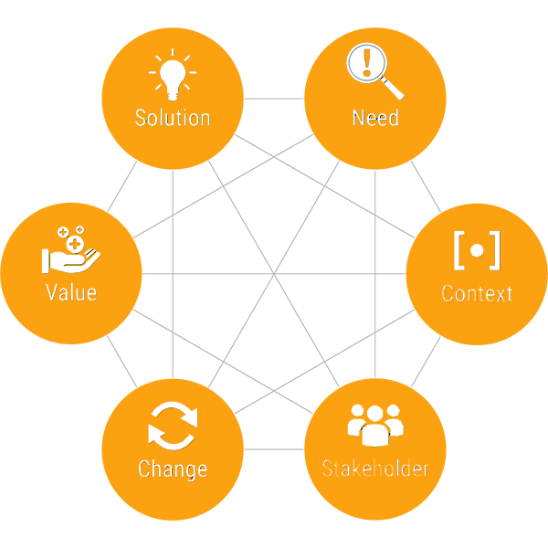
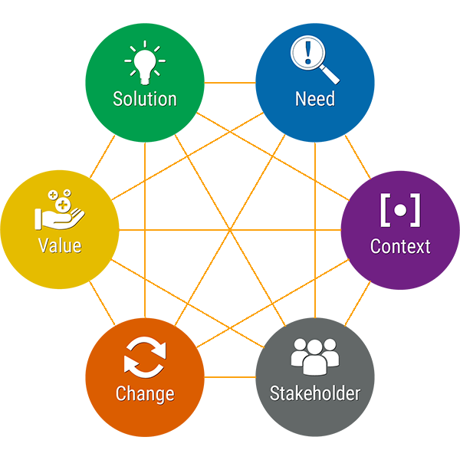
Six Core Concept:

Slide 8
Restrictions:
Lack of Manpower
Transportation Issues
Higher Focus on Local Products
Lower Salaries and Layoffs
Identification of New Work Strategies
Import Issues
Reduced Cost to Company

Slide 9
New Sales Channels
Online Sales Channels
Higher Brand Awareness
New Job Opportunities
Contactless deliveries & installations
Internal Hires (Employees)
Outside Hires (Community)

Slide 10
Assignment 1
Thank You
Emma Cohen - Ikenna Daniel Nwankwo - Lamis Salloum Yared - Rohan Upadhaya - Vaishnavi Pritam Veer
Notes:
As you can see a company could have a core mission or vision but the only thing permanent in the world is change. it could be unforeseen or planned, regardless we need to stay in line with our goal and the Mandelow's matrix and the six core concept helps us to achieve that. It provides a clarity that we need in the face of changes and thus helps stay in line with the company's vision and the ever changing missions.

